Slide 1
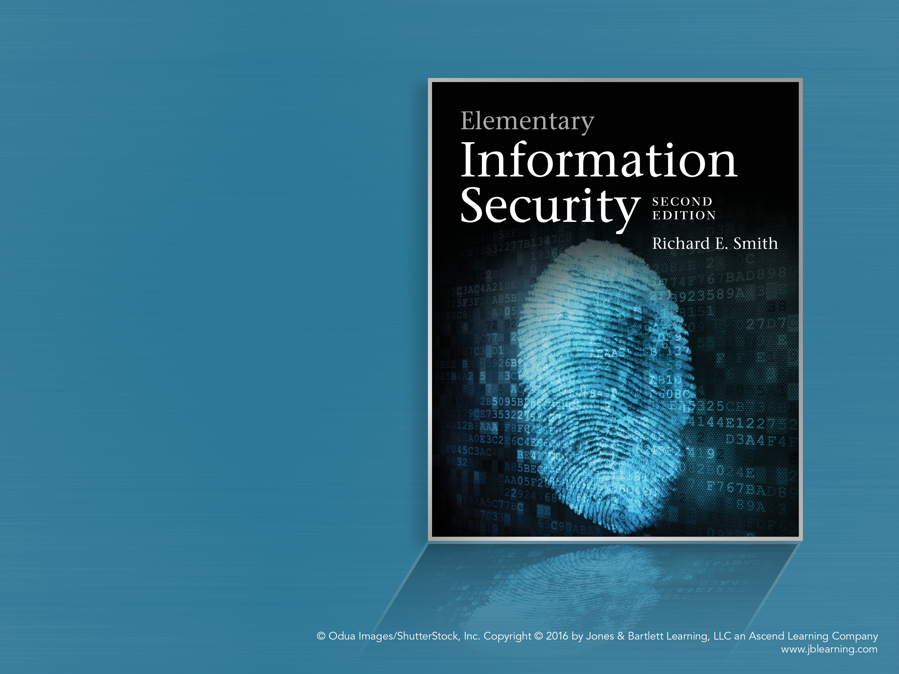
Chapter 3
Controlling Files

Slide 2
Chapter 3 Overview
The file system and file access rights
Executable files
Computer viruses and malware
Policies for file protection
Security controls and file permission flags
Information states
Security patching

Slide 3
The File System
Modern computers keep files in a hierarchy of names – a hierarchy of “folders” or “directories”
Each file has a path name
  Identifies the directory entries to follow to find the file
  The file name selects the right file in the final directory in the path
Files are owned by a user, usually the creator
  Access rights are tied to user identities
  Example: Bob can read the file, but Alice can’t

Slide 4
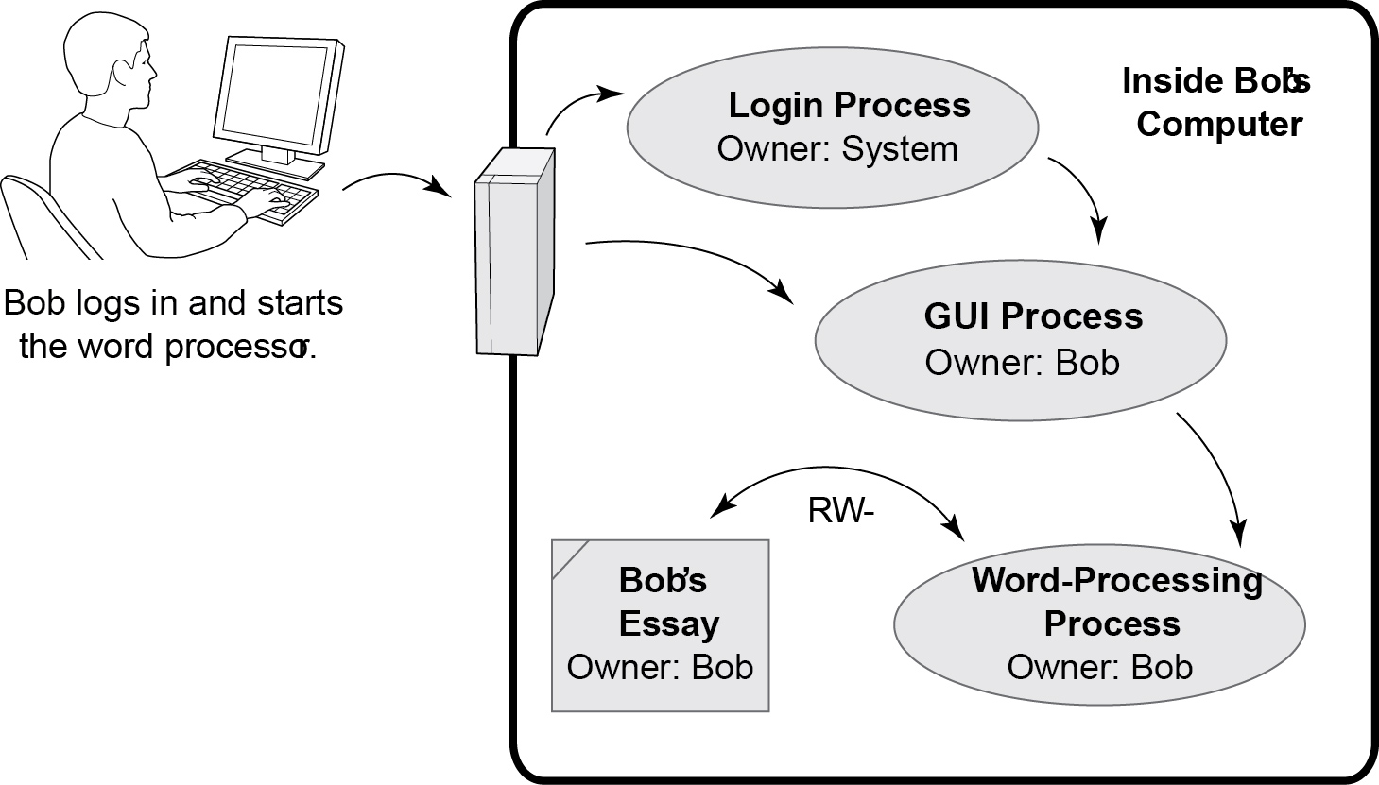
Process Ownership and Access

Slide 5
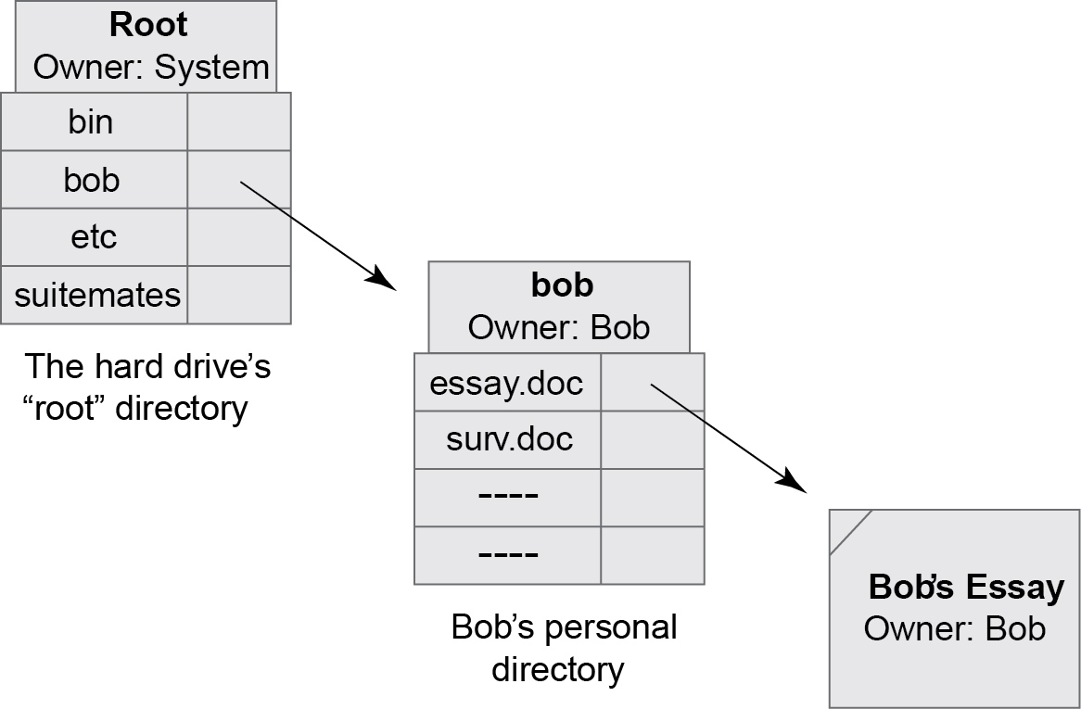
File and Directory Ownership

Slide 6
File and Directory Access Rights
“CRUD” – Create, Read, Update, Delete
  Many systems let us control those rights
  Different effects on files and directories
    “Update” to directory = “delete” to its files
Protecting a newly-created file: two strategies
  Use “Defaults” – apply the same access rights to all new files
    Use “Inheritance” – apply the access rights based on the enclosing directories

Slide 7
Executable Files
Files that contain applications or other executable programs
  “Binary executables” are stored in a control section and executed by the CPU
  “Scripts” contain text interpreted by a programming language interpreter
Execute Access Right
  Helps distinguish data files from programs
  Must have the “Execute” right to execute a file containing a program

Slide 8
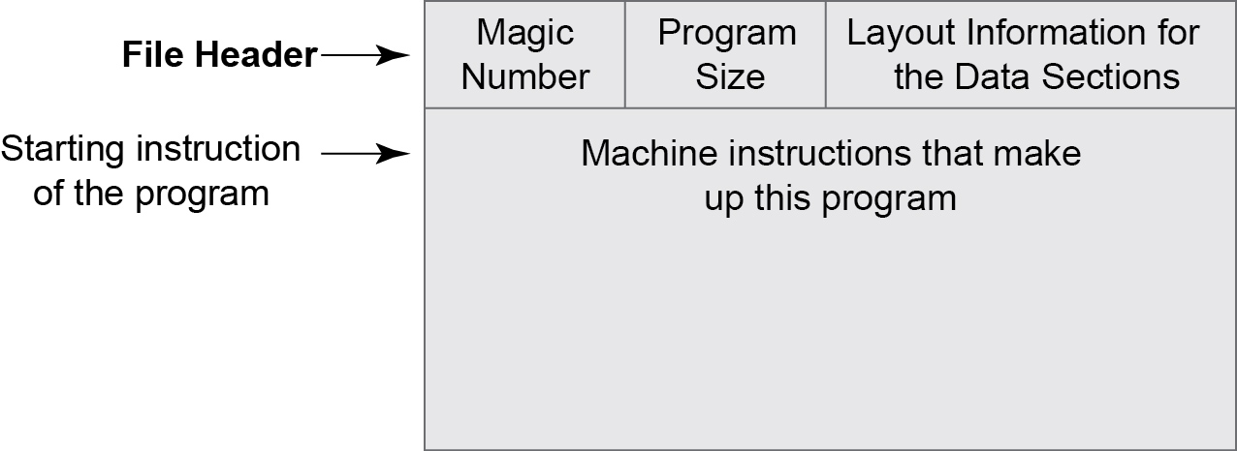
Format of a Binary Executable file

Slide 9
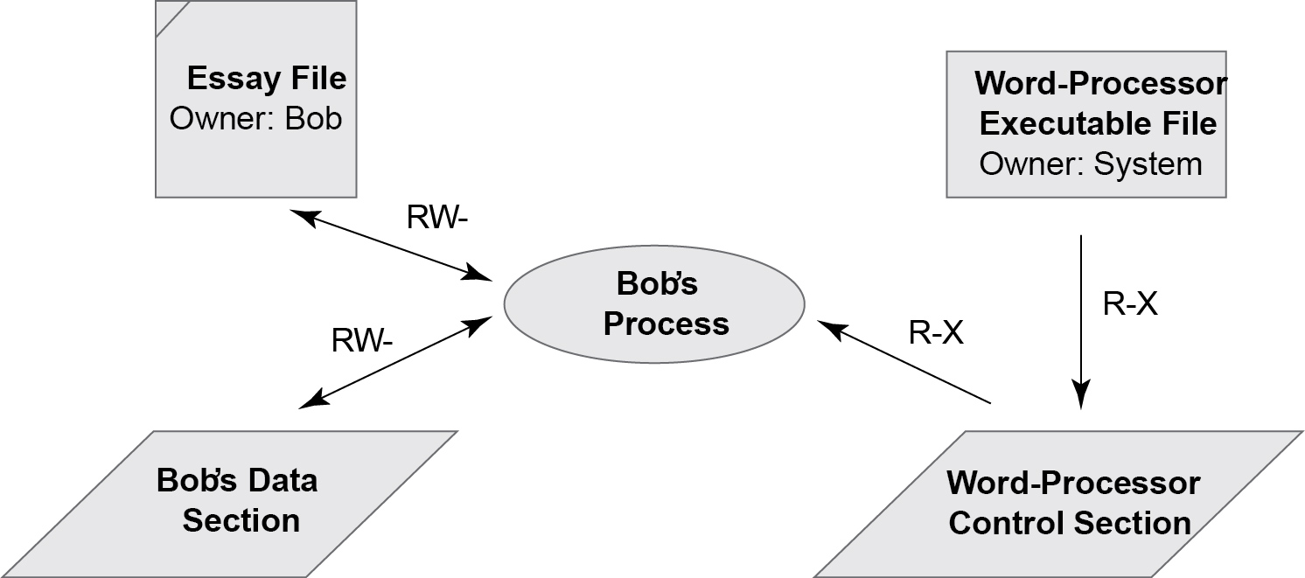
Execute Access Rights

Slide 10
Computer Viruses
A type of malware that enters computer systems.
  Malware = malicious software
Viruses are carried by programs
  When the program executes, the virus spreads to other programs on the computer
Types of virus infection
  Application program infects when it is run
  Boot sector virus infects when bootstrapped
  USB virus infects when plugged in
  Email virus infects if attachment is run

Slide 11
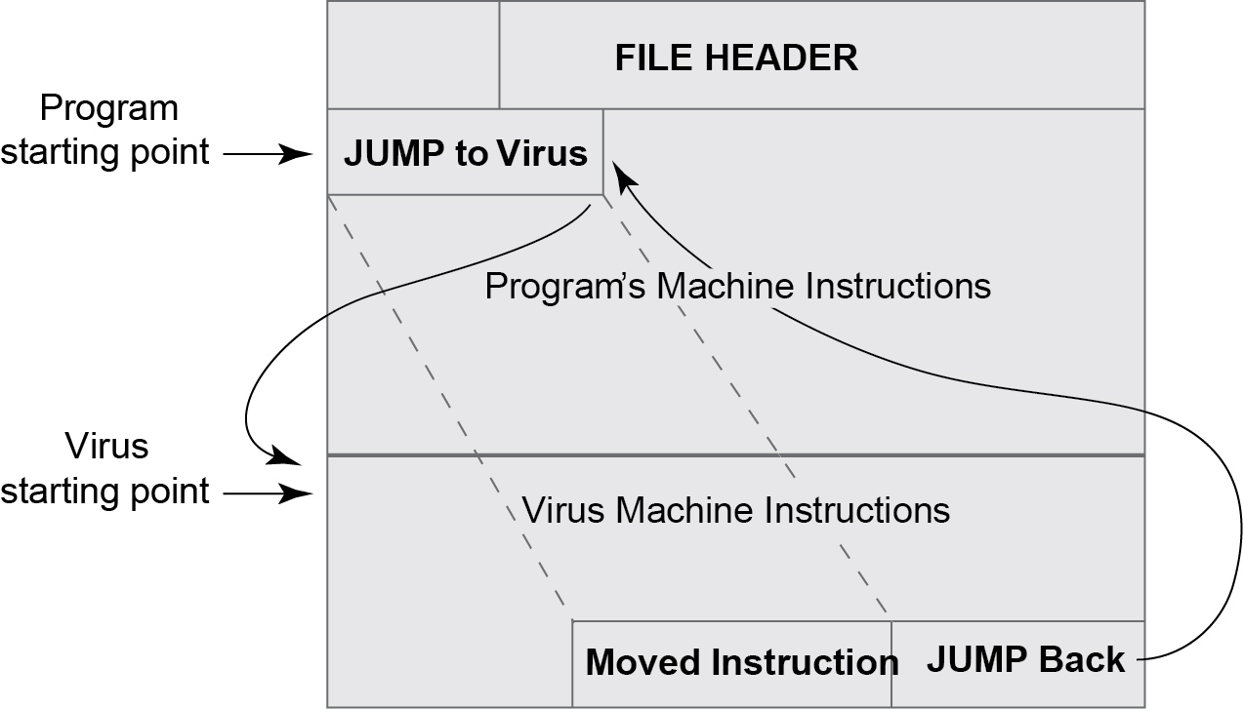
An Infected Application Program

Slide 12
Examples of Modern Malware
Waledac – spreads through email – creates a botnet that spreads spam and more malware.
Conficker or Downadup – spread through Internet via Windows vulnerabilities – created a botnet used for spam and malware distribution.
Pushdo/Cutwail – A botnet and spam package that used to produce 7 million messages a day.
ZeuS – creates botnet focused on financial fraud
Stuxnet – attacks control logic in industrial plants; probable target was Iranian nuclear sites

Slide 13
Sharing and Protecting Files
Objectives for sharing files
  Provide computing for authorized users
  Preserve the Chain of Control
  Permit/prevent general sharing among users
Risks – a generic set
  Denial of service
  Subversion
  Masquerade
  Disclosure
  Forgery

Slide 14
Policy Alternatives
Global Policies – applied to all users by default
  Isolation Policy – keep users separate
  Sharing Policy – let users share their files
Tailored Policies
  Modify rights for specific sets of files
  Specific tailorings
    Privacy – block some files from sharing
    Shared reading – share some blocked files
    Shared updating – full rights for some users

Slide 15
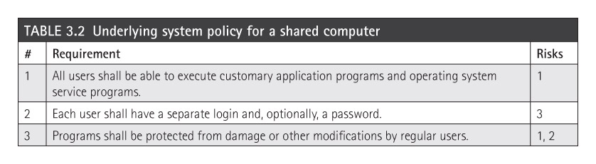
Underlying Policy on Shared System
Our policy must make it possible for users to share application programs.
  Three policy statements below allow this while defending against related risks.

Slide 16
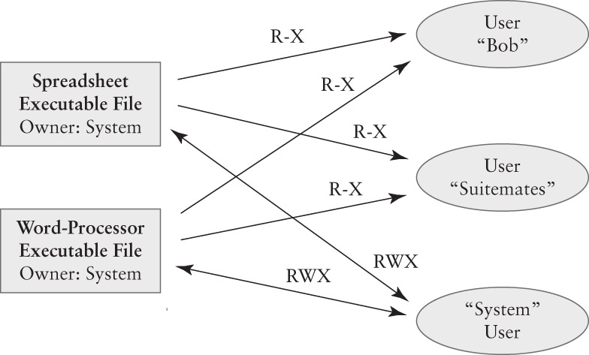
Executable Access Rights

Slide 17
A Global Isolation Policy
By default, all personal files are kept private
Specific shared files are available
  Addressed by the first 3 policy statements
Global policy requires one added rule:
# | Policy Statement | Risks
4 | Files belonging to one user shall be protected from any access (read or write) by other users | 1, 2, 5

Slide 18
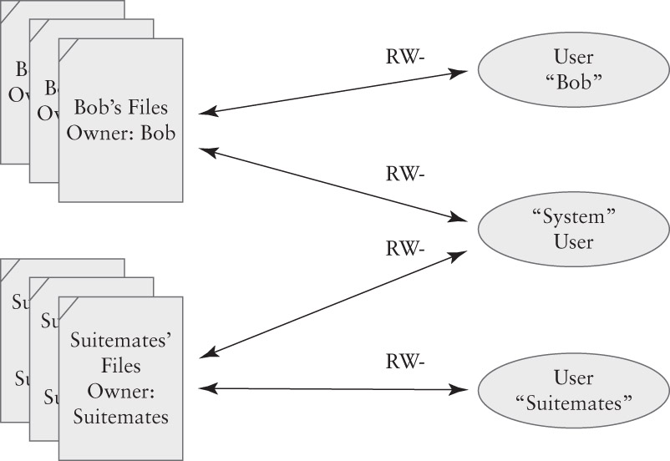
Isolation Policy

Slide 19
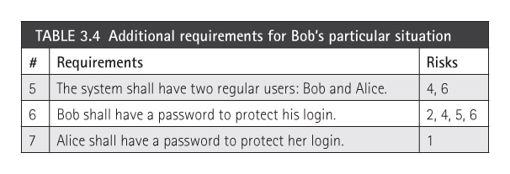
Bob’s Policy
Bob perceives another risk:
  6. Unauthorized access to client data
To address this, he adds this requirement:

Slide 20
A Global Sharing Policy
By default, all personal files are shared
  Readable by others but not writeable
Application files are also shared
  Addressed by the first 3 policy statements
Global policy requires two statements
  Replaces #4 in the global isolation policy
# | Policy Statement | Risks
4 | Files belonging to one user shall be readable by others | 1
5 | Files belonging to one user shall be protected from writing by others. | 1, 3, 5

Slide 21
Security Controls
An operating system can protect files as long as:
  The OS protections are always applied when we access our files, and
  There is no way to bypass the OS protections
Basic Principle: Deny by Default
  We always start by granting no access
  We add access rights
  This makes it easier to assign the right permissions and achieve Least Privilege

Slide 22
Managing Access Rights
Access Matrix contains two dimensions
  A full matrix is too large for practical use
  We can organize access rights by clustering in one dimension or the other
Cluster by Column = Capability-Based Security
  We associate rights with users, processes, or other active entities
  A key-ring is a set of capabilities: ownership grants access to the locked items
  Tickets provide capabilities

Slide 23
Cluster by Row = File Permissions
Currently the most popular strategy in OSes
  Access rights are associated with resources like files, devices, storage areas, etc.
  The list of rights tells which users/processes have which access rights.
Implementations Today
  File Permission Flags – Unix
  Access Control Lists – Windows, OS X
  Detailed examples – Next Chapter

Slide 24
Permission Flags in General
Sets of flags to specify access rights. Example:
  RWX = Read, Write, Execute access rights
A set of flags for each type of process
  Processes belonging to the file’s owner
  Processes belonging to the system
  Processes belonging to others – the world
Still too redundant: owner and system often have full access to the files anyway
Compact access rules specify world rights only.

Slide 25
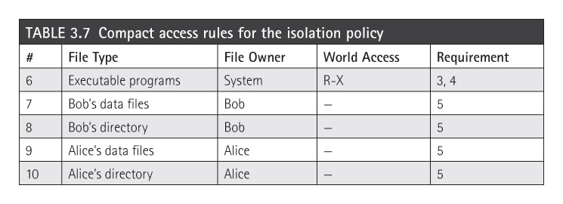
Compact access rules for Bob’s Files
A simple way to list file security controls to enforce basic or global security policies
  Specify the files, their owners, and the access rights for the other users on the system.
  These are “Logical” controls

Slide 26
States and State Diagrams
A technique to illustrate a system’s behavior
  Each state is a separate situation
  Arrows between states show transitions
    A transition indicates both cause and effect
    An event causes the transition
    An action may take place at the transition
A door may be Open or Closed – two states
The events Opening or Closing cause the transition between the states

Slide 27
Information States
Data or information may be in these basic states
  Storage state
    Stored in a computer, not being processed
    “Data at rest”
  Processing state
    Being used by an active process
    Usually stored in RAM
  Transmission state
    Being moved from one place to another
    “Data in motion”

Slide 28
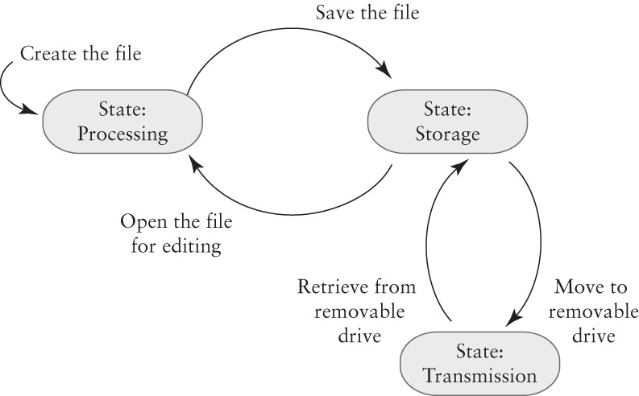
Example: Bob’s Essay

Slide 29
The Security Patch Race
A race begins when a security problem arises
  The software developer races to develop a fix to eliminate the problem
  Attackers race to write software that exploits the problem and lets them attack computers
    Attack software is called an exploit
Any computer that doesn’t patch the problem may be vulnerable to the exploit
Window of vulnerability = time during which an exploit exists but computers aren’t patched

Slide 30
Patching Security Flaws
The Patching Process
  Collect error reports
  Prioritize errors and assign to engineers
  Engineer develops software to fix the error
  Software fixes are chosen for a patch
  The patch is tested
  The patch is released
This applies to all flaws including security flaws
  Security fixes may have higher priority

Slide 31
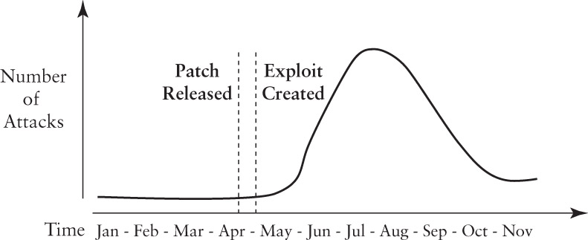
The risk of delayed patching
9am – 10am – 11am – 12pm – 1pm – 2pm – 3pm…
(Accelerated time frame)

Slide 32
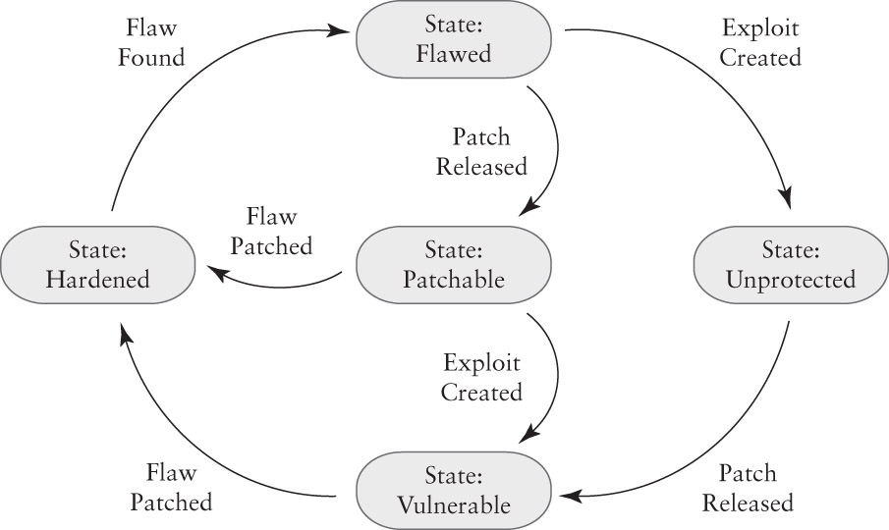
A State Model of Patching

